Slide 1
Bayesian clustering with multi-layer overlapping group structure (MOGC)
Li Zhu
10/09/2018 lab meeting

Slide 2
Review
SOG/MOG are Bayesian variable selection models, which
Incorporate features with multi-layer overlapping group structure (MOG)
Aim for prediction in a linear regression setting
Structured features are also prevalent in clustering problem.
Today, I will introduce the our models SOGC/MOGC extending SOG/MOG to clustering setting.

Slide 3
Outline
Review of multi-layer overlapping group structure and variable selection in clustering
Introduce SOGC and MOGC models
Simulations

Slide 4
Part 1. Background and literature review

Slide 5


Multi-layer overlapping groups (MOG) structure
Level-0 feature
Level-1 group
Level-2 group
 | Gene A | Gene B | Gene C
Gene A CNV | 1 | 0 | 0
Gene A methylation | 1 | 0 | 0
Gene A mRNA | 1 | 0 | 0
miRNA α | 1 | 1 | 0
Gene B CNV | 0 | 1 | 0
Gene B methylation | 0 | 1 | 0
Gene B mRNA | 0 | 1 | 0
Gene C CNV | 0 | 0 | 1
Gene C methylation | 0 | 0 | 1
Gene C mRNA | 0 | 0 | 1
Gene A CNV
Gene A methylation
Gene A mRNA
Gene A
$$U^{(1)}=$$
miRNA α
Pathway θ
Gene B CNV
Gene B methylation
Gene B
Gene B mRNA
Gene C CNV
Pathway φ
 | pathway θ | pathway φ
Gene A | 1 | 1
Gene B | 1 | 0
Gene C | 0 | 1
Gene C methylation
$$U^{(2)}=$$
Gene C
Gene C mRNA
Feature/group shared by overlapping groups

Slide 6
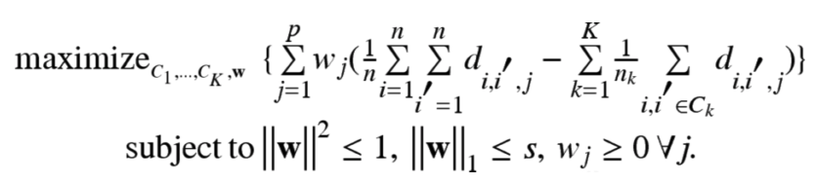


Literature review: variable selection in clustering
Clustering:
Hierarchical clustering (Eisen et al. 1998), K-means (Dudoit et al. 2002), mixture models (Pan et al. 2007)
Variable selection in clustering:
Penalized objective function:
Sparse K-means (Witten and Tibshirani 2010)
Penalized normal mixture model (Pan and Shen 2007)
Between-cluster sample of squares
Sample pairwise distance
Penalized log-likelihood
L1 penalty

Slide 7
Bayesian clustering model with variable selection
Kim et al. 2006 Biometrika
Normal mixture models (Dirichlet process mixture model)
Latent binary indicator for variable selection
For each feature, define a binary indicator:
Conditional on the discriminant variables
Conditional on the non-discriminant variables

Slide 8
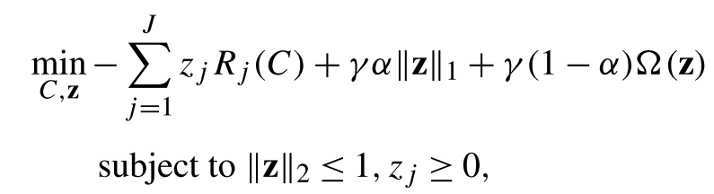
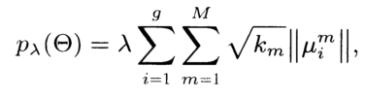
When features are structured in groups
K-means setting
Huo and Tseng (2017) developed Integrative sparse K-means (ISKM)
Normal mixture model setting
Xie et al. 2008 extended the penalized normal mixture models in Pan and Shen 2007.
J :Study index
Overlapping group lasso penalty
BCSS/TSS
Group lasso like penalty
i is cluster index; m is group index

Slide 9
Part 2. SOGC/MOGC model

Slide 10
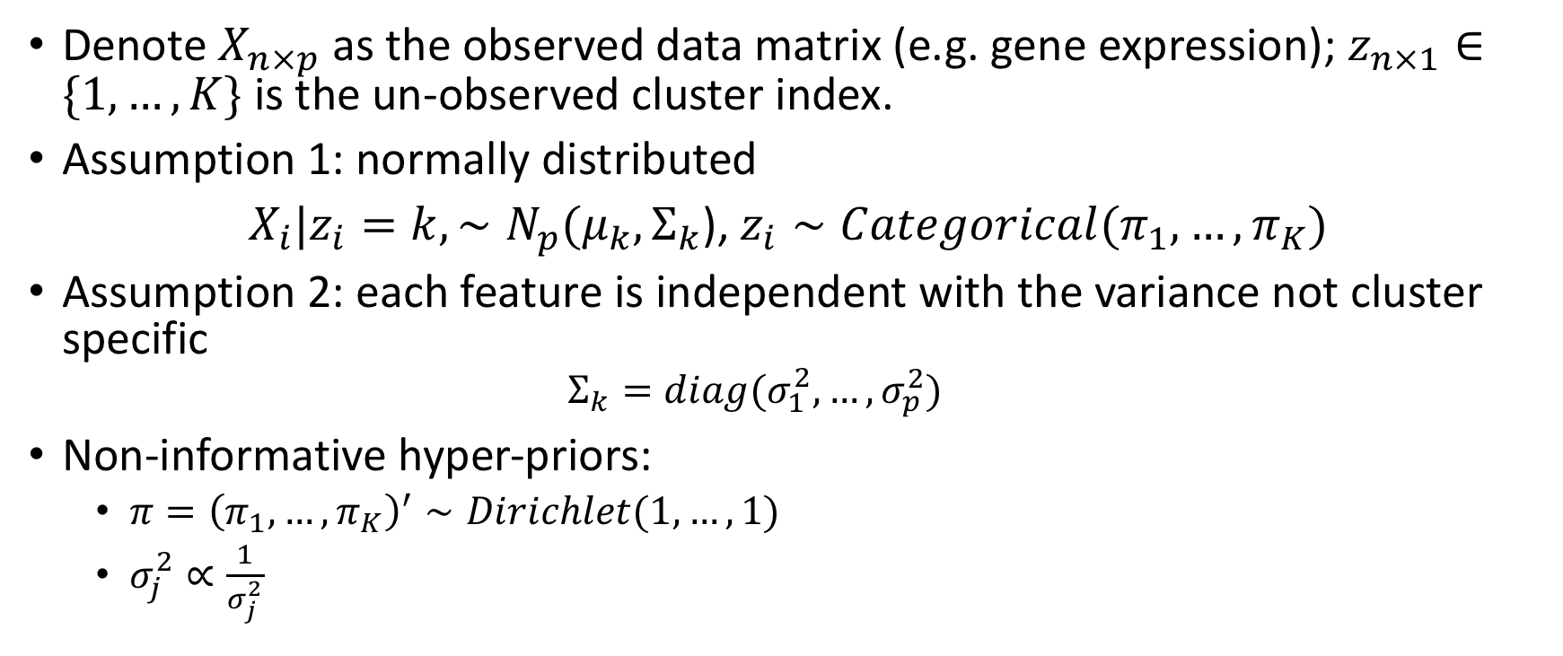
Clustering problem setting: normal mixture model and notations
Denote $X_{n×p}$ as the observed data matrix (e.g. gene expression); $z_{n×1}∈\{1, …, K\}$ is the un-observed cluster index.
Assumption 1: normally distributed
$X_{i}|z_{i}=k, ∼N_{p}(μ_{k}, Σ_{k}$), $z_{i}∼Categorical(π_{1},…, π_{K})$
Assumption 2: each feature is independent with the variance not cluster specific
$$Σ_{k}=diag(σ_{1}^{2}, …, σ_{p}^{2})$$
Non-informative hyper-priors:
$π={\left(π_{1},…, π_{K}\right)}^{′}∼Dirichlet(1, …, 1)$
$σ_{j}^{2}∝\frac{1}{σ_{j}^{2}}$

Slide 11
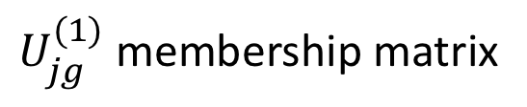
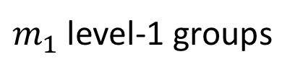
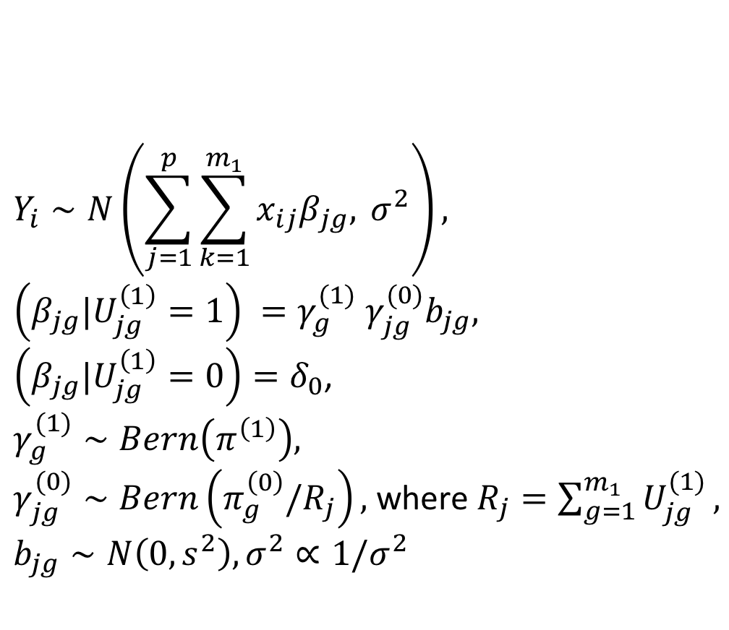
Review: single layer overlapping groups (SOG)
$m_{1}$ level-1 groups
$$Y_{i}∼N\left(\sum_{j=1}^{p}{\sum_{k=1}^{m_{1}}{x_{ij}β_{jg}, }}σ^{2}\right),$$
$\left(β_{jg}|U_{jg}^{\left(1\right)}=1\right) {=γ}_{g}^{(1)}$ $γ_{jg}^{(0)}b_{jg},$
$\left(β_{jg}|U_{jg}^{\left(1\right)}=0\right)=δ_{0}$,
$$γ_{g}^{(1)}∼Bern\left(π^{\left(1\right)}\right),$$
$γ_{jg}^{(0)}∼Bern\left(π_{g}^{\left(0\right)}/R_{j}\right),$ where $R_{j}=\sum_{g=1}^{m_{1}}{U_{jg}^{(1)}},$
$$b_{jg}∼N\left(0, s^{2}\right), σ^{2}∝1/σ^{2}$$
 | group 1 | group 2 | group 3
feature 1 | 1 | 0 | 0
feature 2 | 0 | 1 | 1
feature 3 | 0 | 0 | 1
feature 4 | 1 | 1 | 0
p level-0 features
$U_{jg}^{(1)}$ membership matrix
1 for in
0 for out

Slide 12
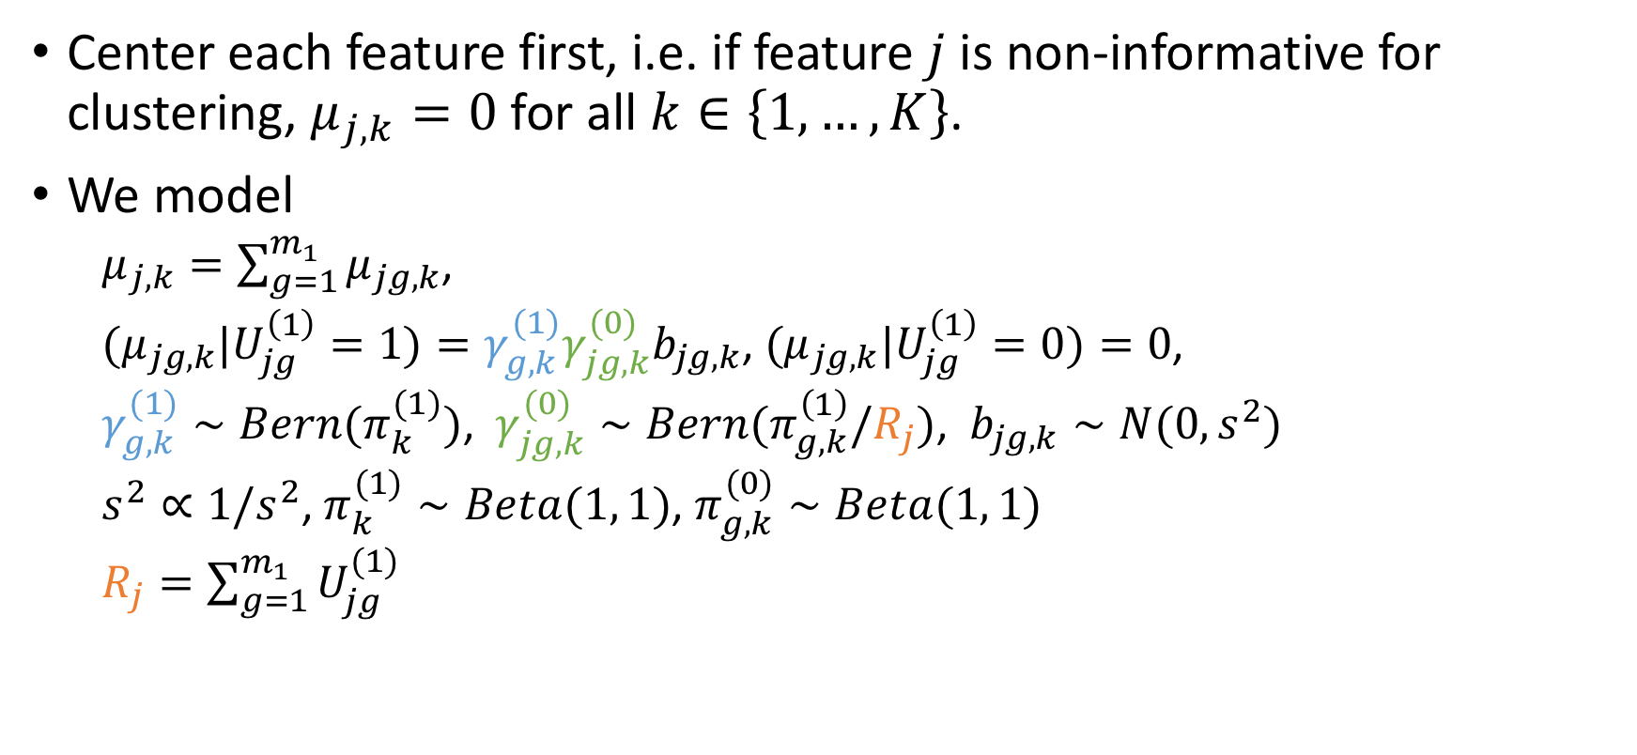
SOGC: clustering with single-layer overlapping groups
Center each feature first, i.e. if feature $j$ is non-informative for clustering, $μ_{j,k}=0$ for all $k∈\left\{1, …, K\right\}$.
We model
$μ_{j,k}=\sum_{g=1}^{m_{1}}{μ_{jg,k}}$,
${(μ}_{jg,k}|U_{jg}^{\left(1\right)}=1)=γ_{g,k}^{(1)}γ_{jg,k}^{(0)}b_{jg,k}$, ${(μ}_{jg,k}|U_{jg}^{\left(1\right)}=0)=0$,
$γ_{g,k}^{(1)}∼Bern(π_{k}^{(1)})$, $γ_{jg,k}^{(0)}∼Bern(π_{g,k}^{\left(1\right)}/R_{j})$, $b_{jg,k}∼N(0, s^{2})$
$s^{2}∝1/s^{2}$, $π_{k}^{(1)}∼Beta(1, 1)$, $π_{g, k}^{(0)}∼Beta(1, 1)$
$R_{j}=\sum_{g=1}^{m_{1}}{U_{jg}^{(1)}}$

Slide 13
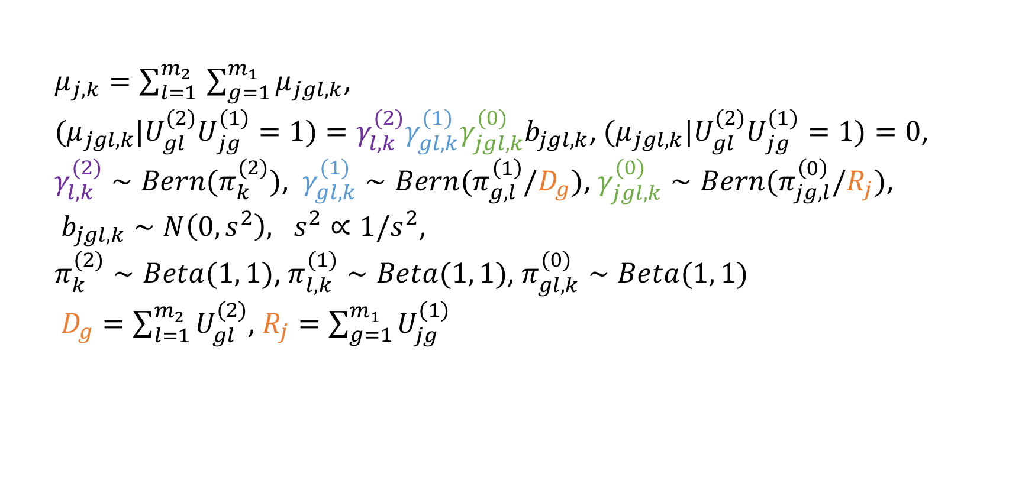
MOGC: clustering with multi-layer overlapping groups
$μ_{j,k}=\sum_{l=1 }^{m_{2}}{\sum_{g=1}^{m_{1}}{μ_{jgl,k}}}$,
${{{(μ}_{jgl,k}|U}_{gl}^{(2)}U}_{jg}^{(1)}=1)={γ_{l,k}^{(2)}γ}_{gl,k}^{(1)}γ_{jgl,k}^{(0)}b_{jgl,k}$, ${{{(μ}_{jgl,k}|U}_{gl}^{(2)}U}_{jg}^{(1)}=1)=0$,
$γ_{l,k}^{(2)}∼Bern(π_{k}^{(2)})$, $γ_{gl,k}^{(1)}∼Bern(π_{g,l}^{\left(1\right)}/D_{g})$, $γ_{jgl,k}^{(0)}∼Bern(π_{jg,l}^{\left(0\right)}/R_{j})$,
$b_{jgl,k}∼N\left(0, s^{2}\right), s^{2}∝1/s^{2}$,
$π_{k}^{(2)}∼Beta(1, 1)$, $π_{l, k}^{(1)}∼Beta(1, 1)$, $π_{gl, k}^{(0)}∼Beta(1, 1)$
$D_{g}=\sum_{l=1}^{m_{2}}{U_{gl}^{(2)}}$, $R_{j}=\sum_{g=1}^{m_{1}}{U_{jg}^{(1)}}$

Slide 14
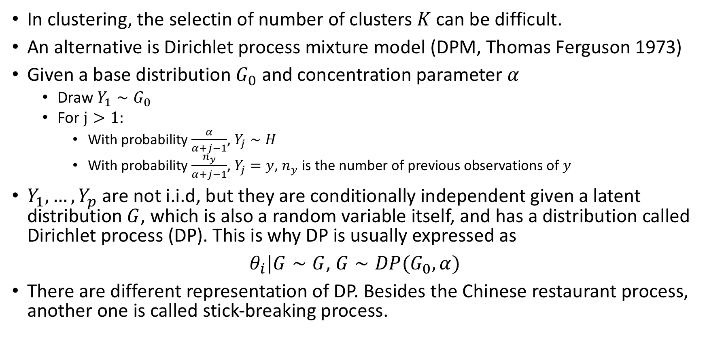
Dirichlet process mixture models
In clustering, the selectin of number of clusters $K$ can be difficult.
An alternative is Dirichlet process mixture model (DPM, Thomas Ferguson 1973)
Given a base distribution $G_{0}$ and concentration parameter $α$
Draw $Y_{1}∼G_{0}$
For $j>1:$
With probability $\frac{α}{α+j−1}$, $Y_{j}∼H$
With probability $\frac{n_{y}}{α+j−1}$, $Y_{j}=y$, $n_{y}$ is the number of previous observations of $y$
$Y_{1},…, Y_{p}$ are not i.i.d, but they are conditionally independent given a latent distribution $G$, which is also a random variable itself, and has a distribution called Dirichlet process (DP). This is why DP is usually expressed as
$θ_{i}|G∼G$, $G∼DP(G_{0},α)$
There are different representation of DP. Besides the Chinese restaurant process, another one is called stick-breaking process.
Chinese restaurant process

Slide 15
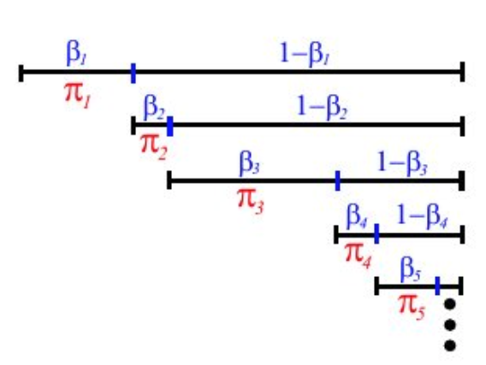
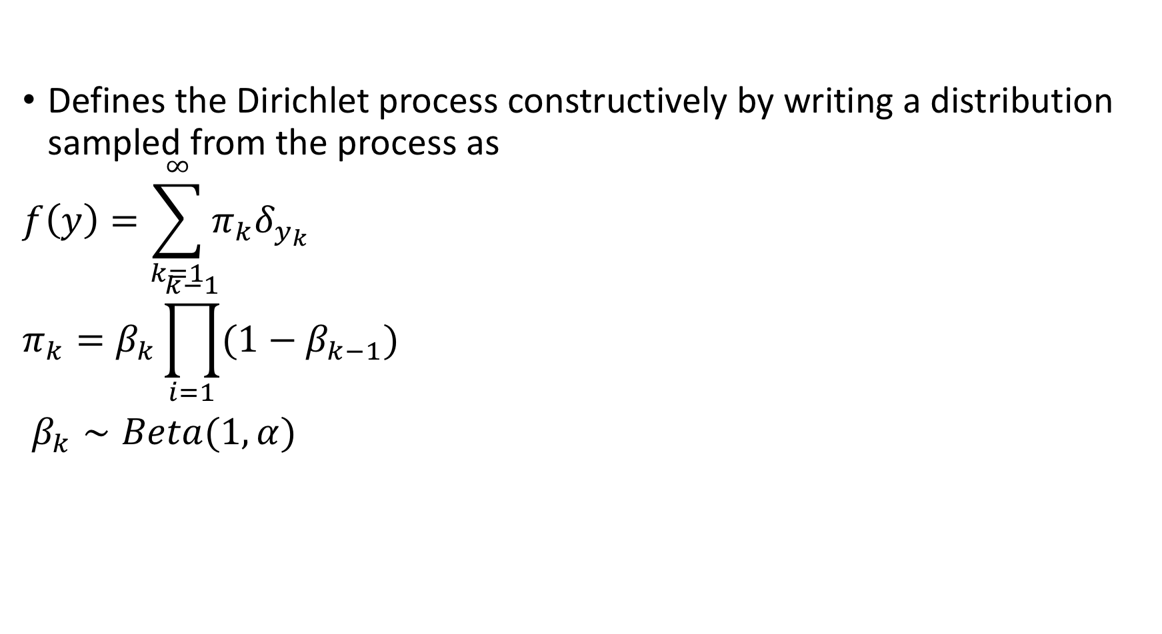
Stick-breaking process
Defines the Dirichlet process constructively by writing a distribution sampled from the process as
$$f\left(y\right)=\sum_{k=1}^{∞}{π_{k}δ_{y_{k}}}$$
$$π_{k}=β_{k}\prod_{i=1}^{k−1}{(1−β_{k−1})}$$
$β_{k}∼Beta(1, α)$

Slide 16
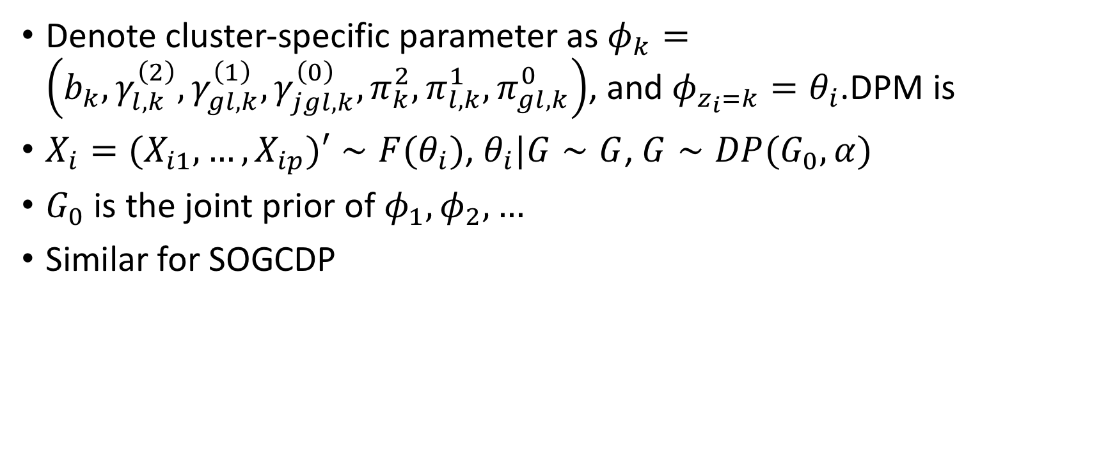
MOGCDP
Denote cluster-specific parameter as $φ_{k}=\left(b_{k}, γ_{l, k}^{\left(2\right)}, γ_{gl,k}^{\left(1\right)}, γ_{jgl,k}^{\left(0\right)}, π_{k}^{2}, π_{l,k}^{1},π_{gl,k}^{0}\right)$, and $φ_{z_{i}=k}=θ_{i}$.DPM is
$X_{i}={(X}_{i1}, …, X_{ip})′∼F(θ_{i})$, $θ_{i}|G∼G$, $G∼DP(G_{0}, α)$
$G_{0}$ is the joint prior of $φ_{1}, φ_{2}, …$
Similar for SOGCDP

Slide 17
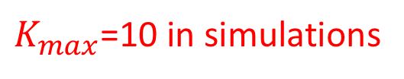
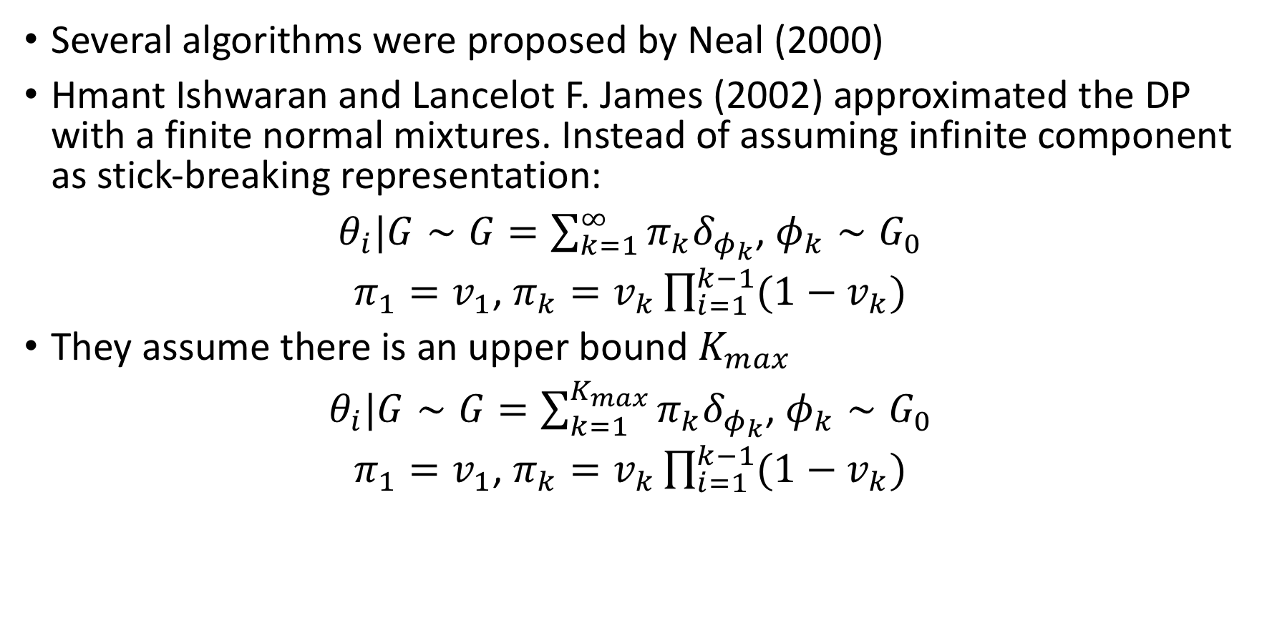
Algorithm for DP: Blocked Gibbs sampling
Several algorithms were proposed by Neal (2000)
Hmant Ishwaran and Lancelot F. James (2002) approximated the DP with a finite normal mixtures. Instead of assuming infinite component as stick-breaking representation:
$θ_{i}|G∼G=\sum_{k=1}^{∞}{π_{k}δ_{φ_{k}}}$, $φ_{k}∼G_{0}$
$π_{1}=v_{1}$, $π_{k}=v_{k}\prod_{i=1}^{k−1}{(1−v_{k})}$
They assume there is an upper bound $K_{max}$
$θ_{i}|G∼G=\sum_{k=1}^{K_{max}}{π_{k}δ_{φ_{k}}}$, $φ_{k}∼G_{0}$
$π_{1}=v_{1}$, $π_{k}=v_{k}\prod_{i=1}^{k−1}{(1−v_{k})}$
$K_{max}$=10 in simulations

Slide 18
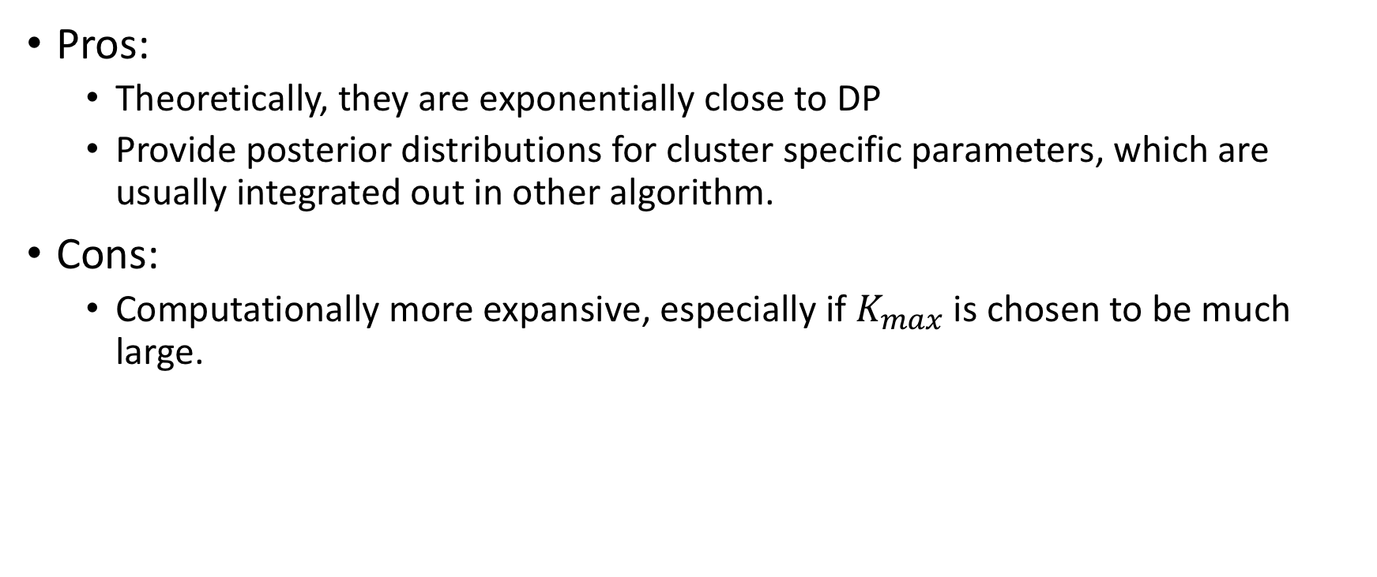
Blocked Gibbs sampling
Pros:
Theoretically, they are exponentially close to DP
Provide posterior distributions for cluster specific parameters, which are usually integrated out in other algorithm.
Cons:
Computationally more expansive, especially if $K_{max}$ is chosen to be much large.

Slide 19
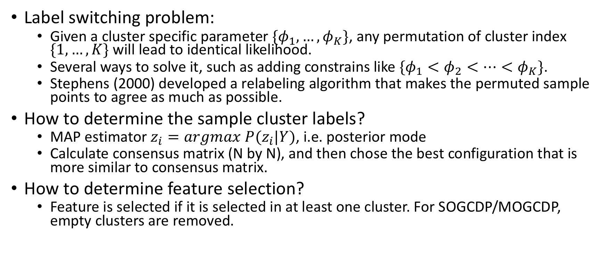
Some issues about MCMC clustering
Label switching problem:
Given a cluster specific parameter $\{φ_{1},…, φ_{K}\}$, any permutation of cluster index $\{1, …, K\}$ will lead to identical likelihood.
Several ways to solve it, such as adding constrains like $\{φ_{1}<φ_{2}<…<φ_{K}\}$.
Stephens (2000) developed a relabeling algorithm that makes the permuted sample points to agree as much as possible.
How to determine the sample cluster labels?
MAP estimator $z_{i}=argmax P(z_{i}|Y)$, i.e. posterior mode
Calculate consensus matrix (N by N), and then chose the best configuration that is more similar to consensus matrix.
How to determine feature selection?
Feature is selected if it is selected in at least one cluster. For SOGCDP/MOGCDP, empty clusters are removed.

Slide 20
Part 3. Simulations

Slide 21
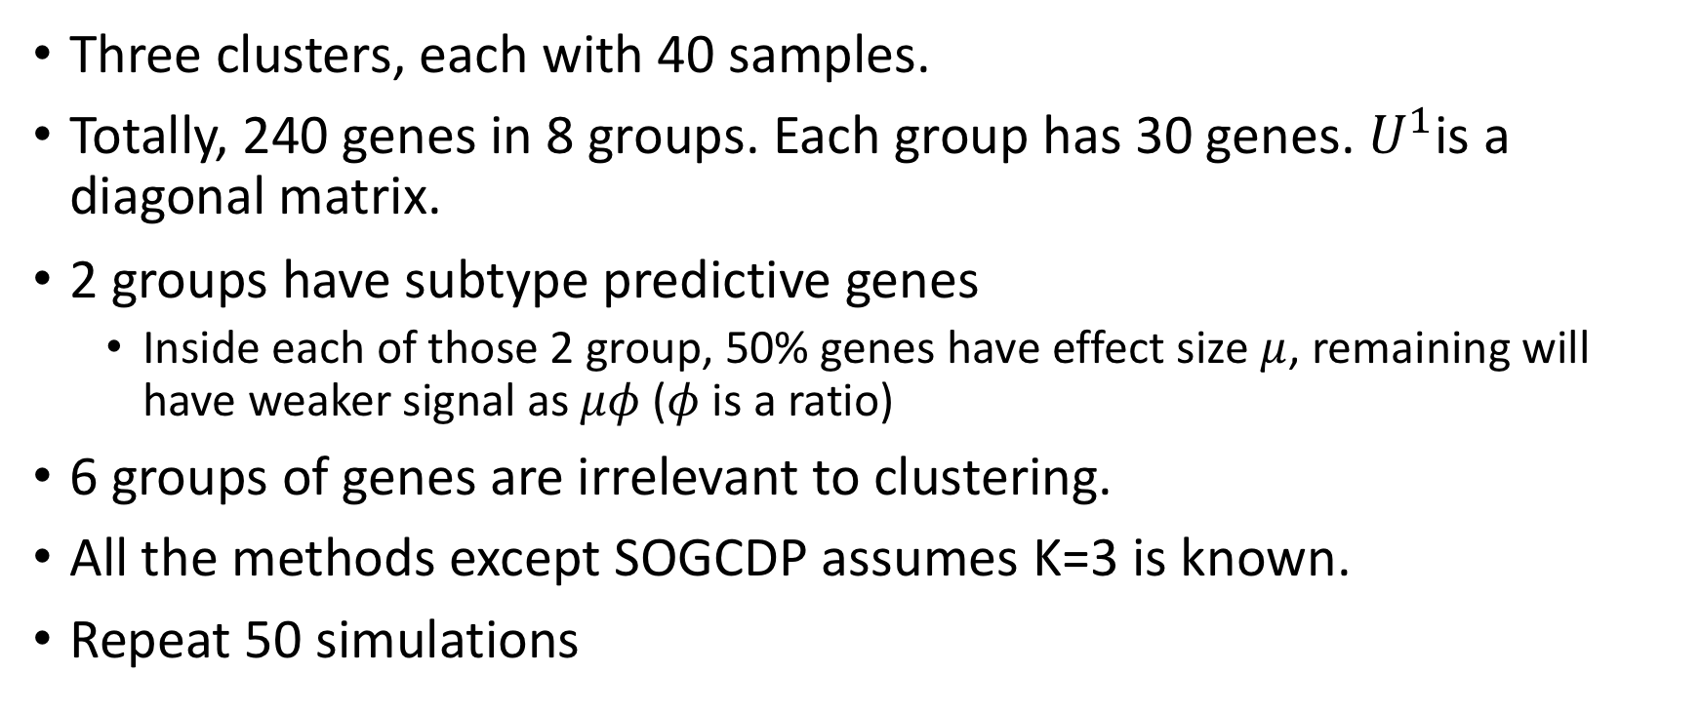
Simulation 1: single-layer groups
Three clusters, each with 40 samples.
Totally, 240 genes in 8 groups. Each group has 30 genes. $U^{1}$is a diagonal matrix.
2 groups have subtype predictive genes
Inside each of those 2 group, 50% genes have effect size $μ$, remaining will have weaker signal as $μφ$($φ$ is a ratio)
6 groups of genes are irrelevant to clustering.
All the methods except SOGCDP assumes K=3 is known.
Repeat 50 simulations

Slide 22
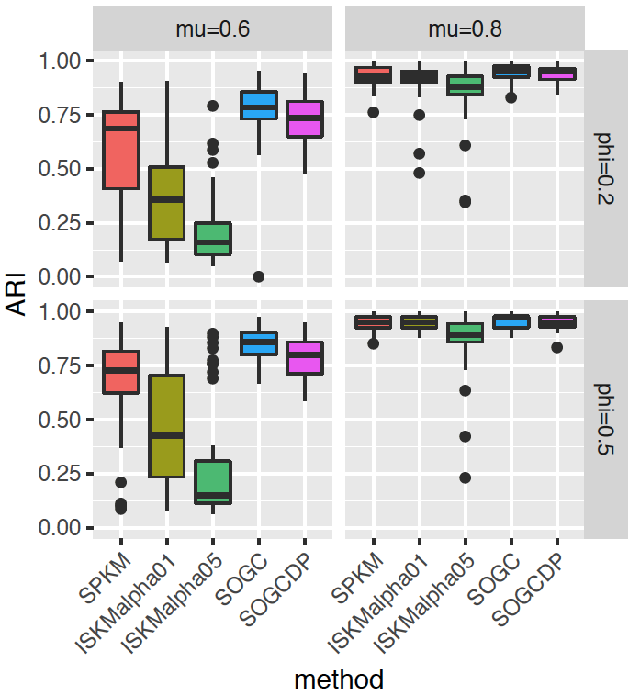
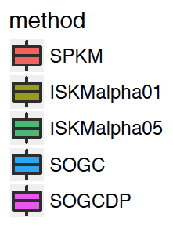
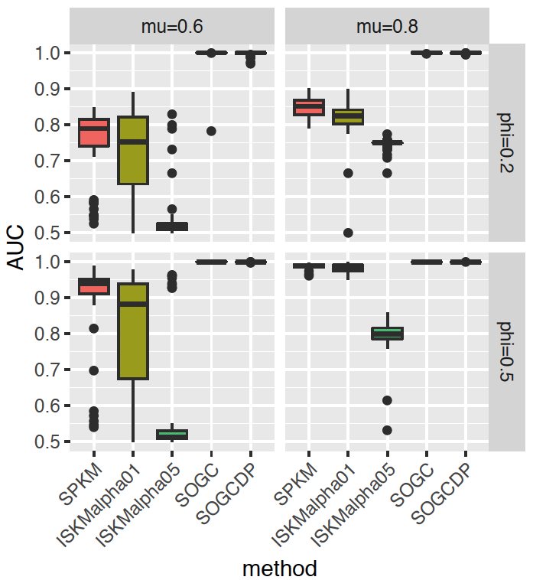
Sample clustering ARI
Variable selection AUC
Higher alpha in ISKM indicates larger group penalty than individual penalty

Slide 23
Simulation 2: single-layer overlapping groups
The only difference from simulation 1 is that, variable 1 and 2 both belong to two groups: group 1 and 2.

Slide 24
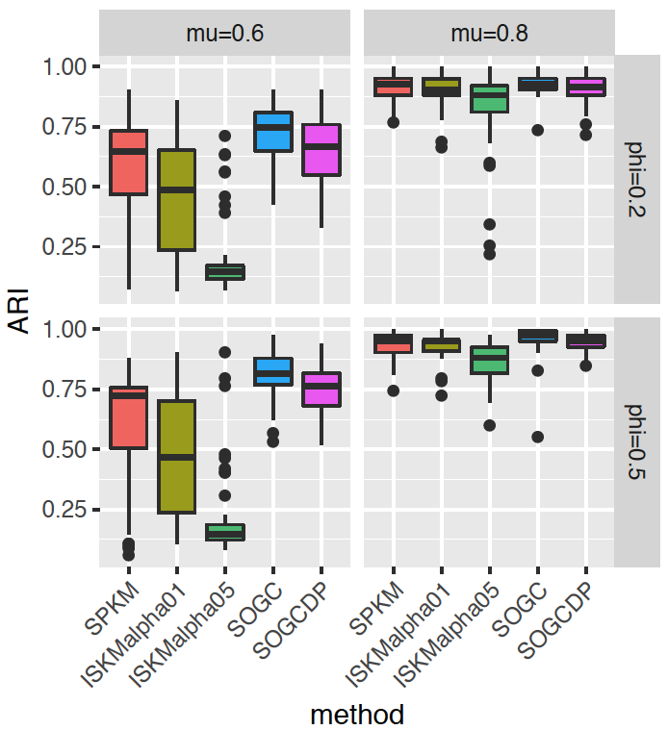
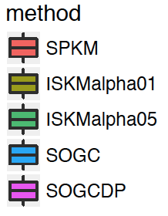
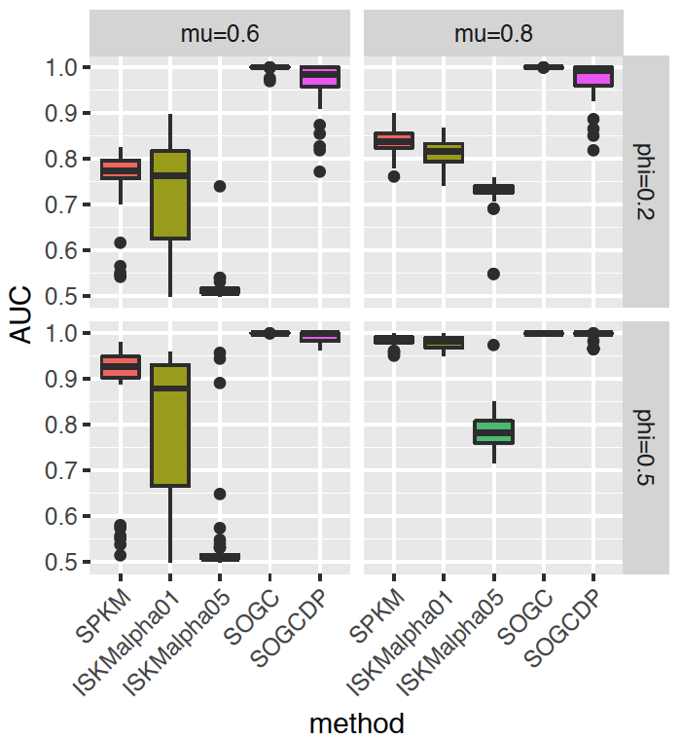
Sample clustering ARI
Variable selection AUC

Slide 25
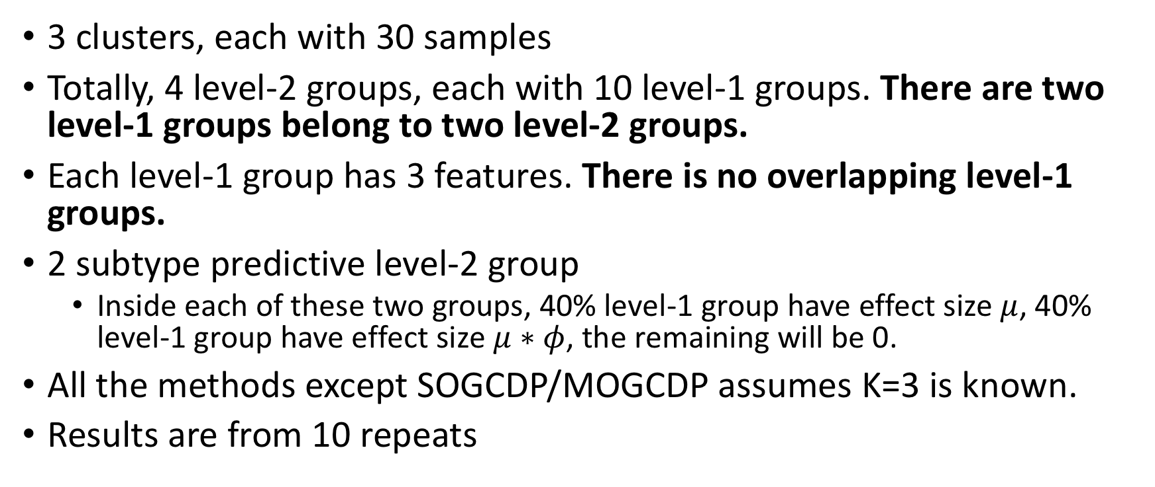
Simulation 3: multi-layer overlapping groups
3 clusters, each with 30 samples
Totally, 4 level-2 groups, each with 10 level-1 groups. There are two level-1 groups belong to two level-2 groups.
Each level-1 group has 3 features. There is no overlapping level-1 groups.
2 subtype predictive level-2 group
Inside each of these two groups, 40% level-1 group have effect size $μ$, 40% level-1 group have effect size $μ∗φ$, the remaining will be 0.
All the methods except SOGCDP/MOGCDP assumes K=3 is known.
Results are from 10 repeats

Slide 26
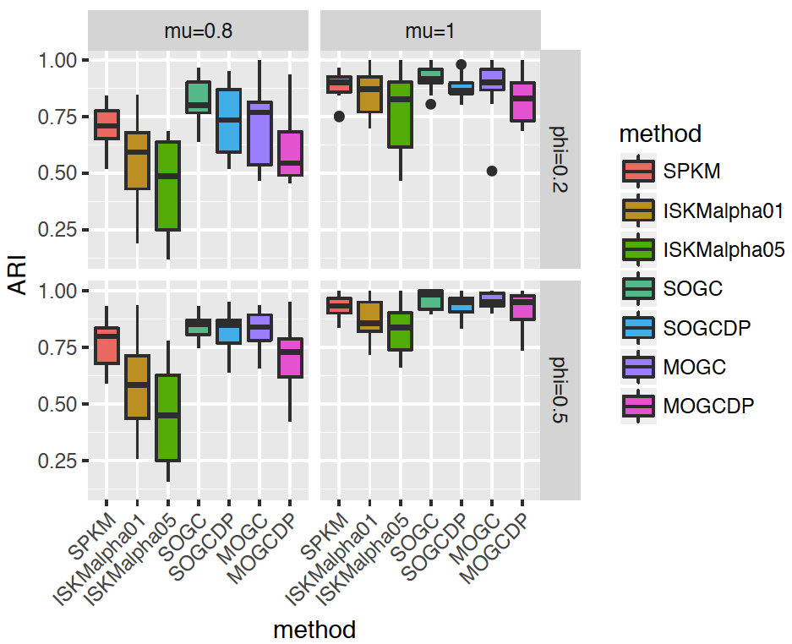
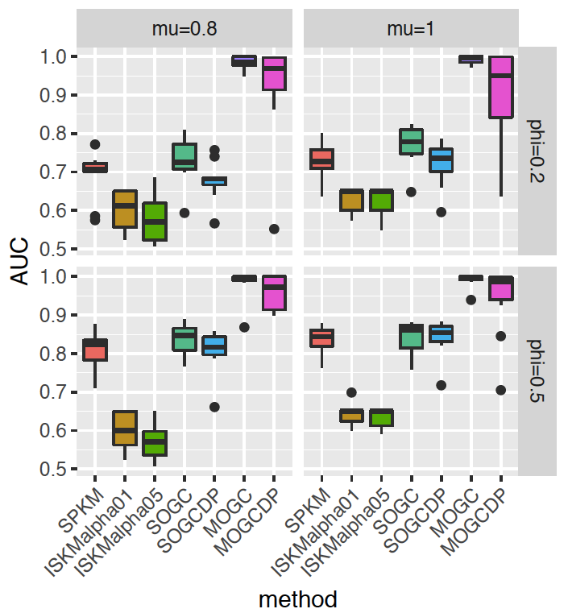
Sample clustering ARI
Variable selection AUC

Slide 27
Plan for applications
ER+ TCGA breast cancer patients: methylation, CNV, mRNA expression
Gene as level-1 group, pathway as level-2 group
Comparing clustering to PAM50 subtype
ER+ METABRIC breast cancer patients: CNV, mRNA expression
Gene as level-1 group, pathway as level-2 group
Comparing clustering to PAM50 subtype
Leukemia dataset: mRNA expression (use one or combine 3?)
GO pathways at the bottom as level-1 group, higher layer pathway as level-2 group
Comparing clustering to 3 leukemia subtypes

